Slide 1

AWS Serverless Data Ingestion Flow
Demonstrating a serverless data ingestion flow on AWS using Step Functions,
Lambda, and Aurora
(… CloudFormation, S3, CloudWatch, and API Gateway too!)
slalom.com

Slide 2
Serverless computing is a cloud computing execution model in which the cloud provider dynamically manages the allocation of machine resources.

Slide 3
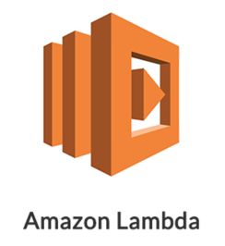
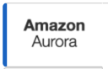


AWS Services

Slide 4
Today’s Agenda
CloudFormation
Lambda
Step Functions
API Gateway
S3
CloudWatch
RDS - Aurora
Notes:
An order processing flow

Slide 5

CloudFormation
Let’s build things…

Slide 6
AWS CloudFormation
AWS CloudFormation provides a common language for you to describe and provision all the infrastructure resources in your cloud environment.
CloudFormation allows you to use a simple text file to model and provision, in an automated and secure manner, all the resources needed for your applications across all regions and accounts.
This file serves as the single source of truth for your cloud environment.
AWS CloudFormation is available at no additional charge, and you pay only for the AWS resources needed to run your applications.
Notes:
Show CFT, CloudFormation execution, and Lambda’s / Role created

Slide 7
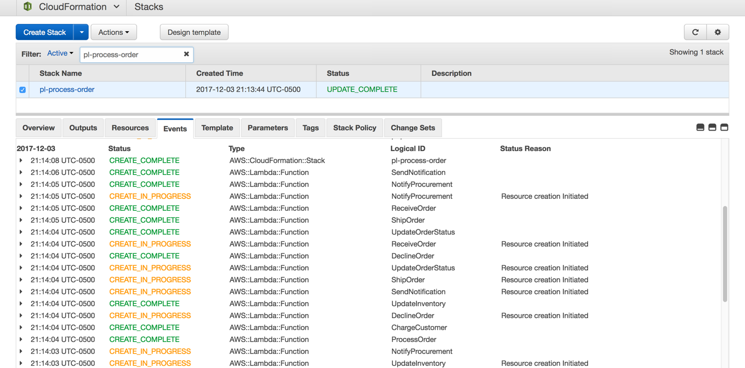
AWS CloudFormation
Notes:
Show CFT, CloudFormation execution, and Lambda’s / Role created

Slide 8
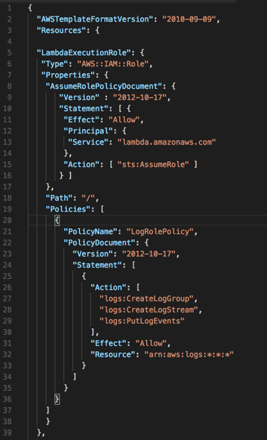
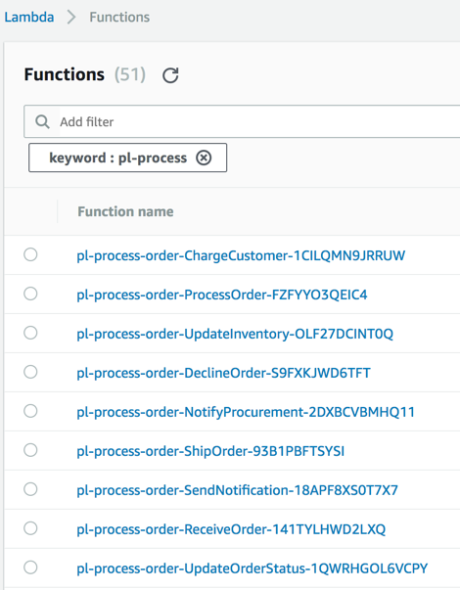
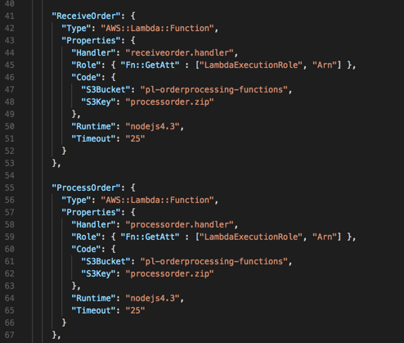
AWS CloudFormation

Slide 9

Lambda
Serverless Compute

Slide 10
AWS Lambda
AWS Lambda lets you run code without provisioning or managing servers.
You pay only for the compute time you consume - there is no charge when your code is not running.
With Lambda, you can run code for virtually any type of application or backend service - all with zero administration.
Upload your code and Lambda takes care of everything required to run and scale your code with high availability.
You can set up your code to automatically trigger from other AWS services or call it directly from any web or mobile app.
Recent announcements:
Can now shift incoming lambda function traffic between 2 different versions (using aliases) based on preassigned weights
Can gradually role out new versions and shift more traffic to them as functionality is confirmed
https://aws.amazon.com/blogs/compute/implementing-canary-deployments-of-aws-lambda-functions-with-alias-traffic-shifting/
Now has double the maximum memory capacity for functions
Good for functions used for big data analysis, large file processing, and statistical computation

Slide 11
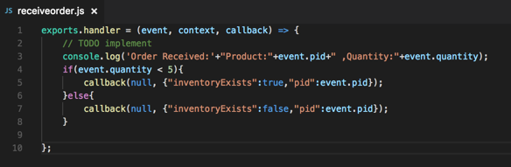
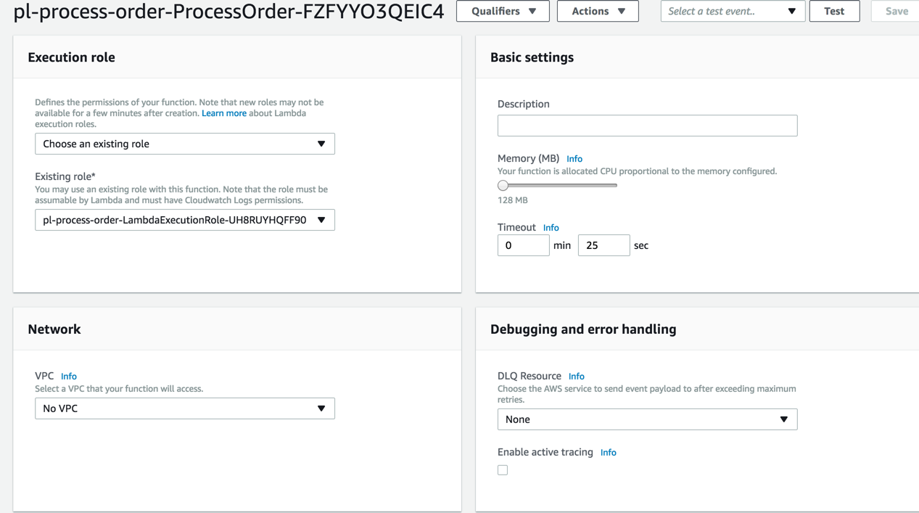
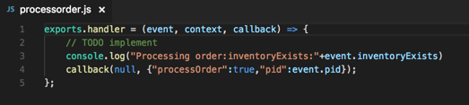
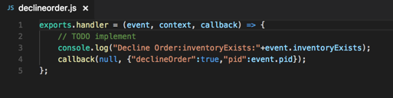
AWS Lambda

Slide 12

Step Functions
State Machines

Slide 13
AWS Step Functions
Step Functions Service is used to create state machines (Workflows).
Orchestrate micro-services into workflow of multi-step applications.
Capable of processing sequential, branching, or parallel steps.
State machine is defined in JSON format and integrates with Lambda functions or custom activities running on EC2.

Slide 14
AWS Step Function Structure
State machine is a group of states.
Each state could be:
Task – Lambda, EC2
Wait – Delay execution from continuing for a specified time
Pass – Usually logging or auditing
Succeed – Force OK
Fail – Force failure
Choice – Conditional, branching
Parallel

Slide 15
Workflow Execution
Execution is an instance of the process or workflow
Workflow execution can be started by:
Starting the state machine execution from the console.
Starting the state machine execution from the command line.
Invoke the step functions using HTTPS endpoint service APIs.
Invoke step functions from AWS SDKs as part of an application.

Slide 16
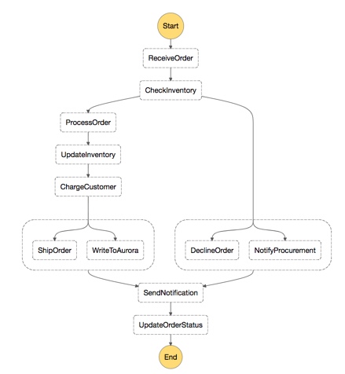
Order Processing Workflow
Notes:
Show code and history

Slide 17
Order Processing Workflow
Inputs:
JSON
Input { “pid” : 1, “quantity” : 5 }
If quantity < 5, then inventory exists = true
“pid” is passed as output from each step to be used as input in the next.
The message output is enriched for other decisions or persistence.

Slide 18


API Gateway, S3, CloudWatch and RDS
slalom.com

Slide 19
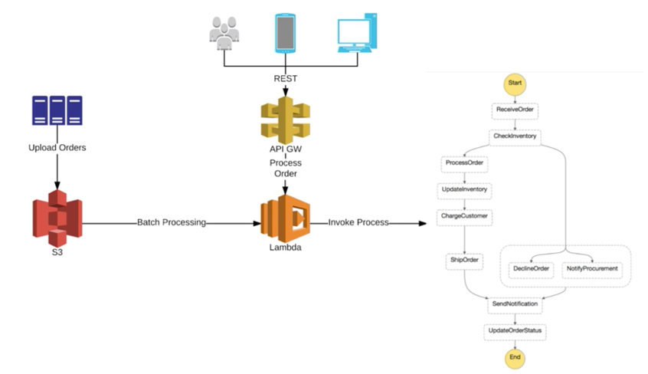
Order Processing Workflow Integration

Slide 20
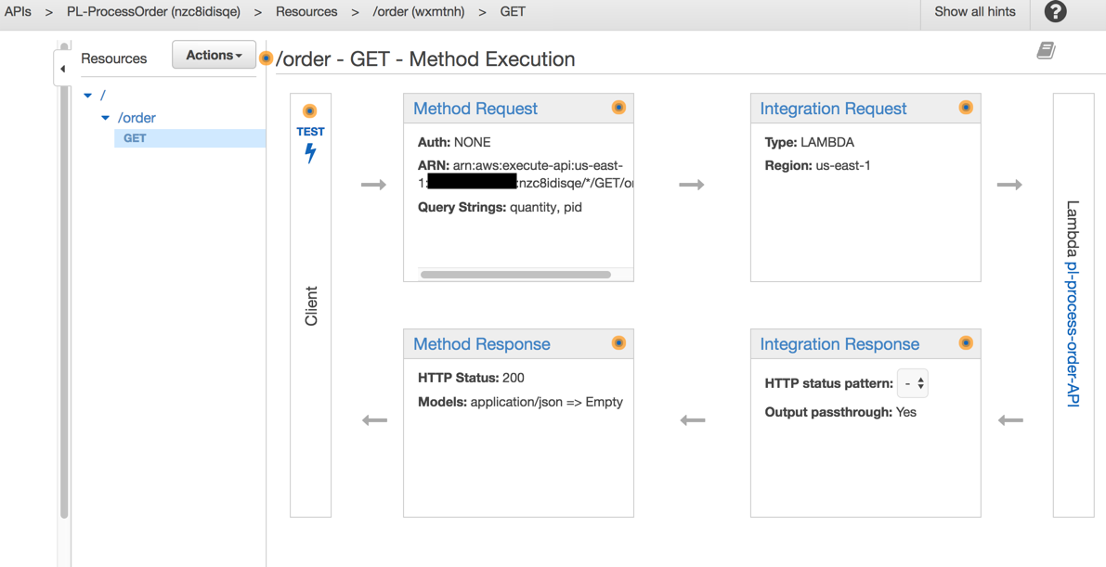
API Gateway Integration

Slide 21
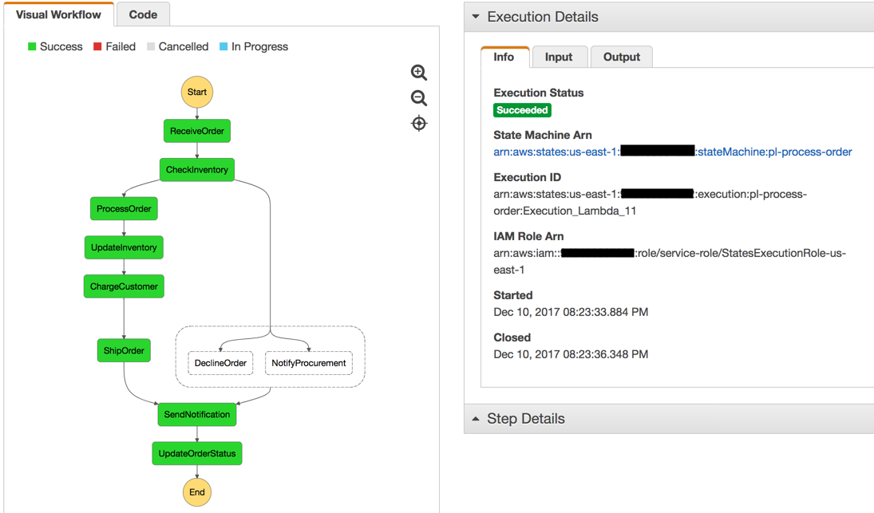
API Gateway Integration

Slide 22
Order Processing S3 Integration
Update IAM Role
Write lambda code
The Step Function SDK is now packaged within lambda
Create ProcessOrder-S3 lambda function
Create S3 bucket in the same region
Add “Object Created” S3 trigger to ProcessOrder-S3 lambda function
Test batch processing by uploading the file to the S3 bucket.

Slide 23
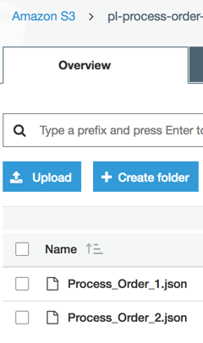
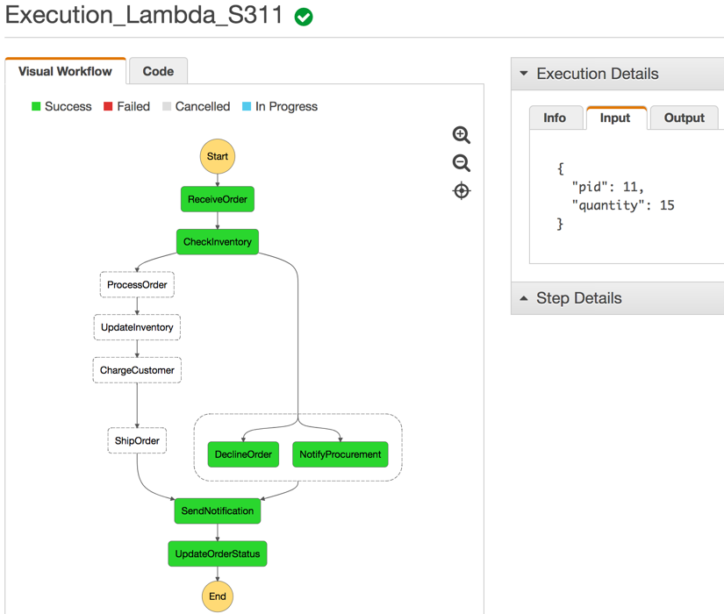
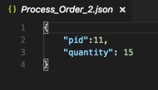
Order Processing S3 Integration

Slide 24
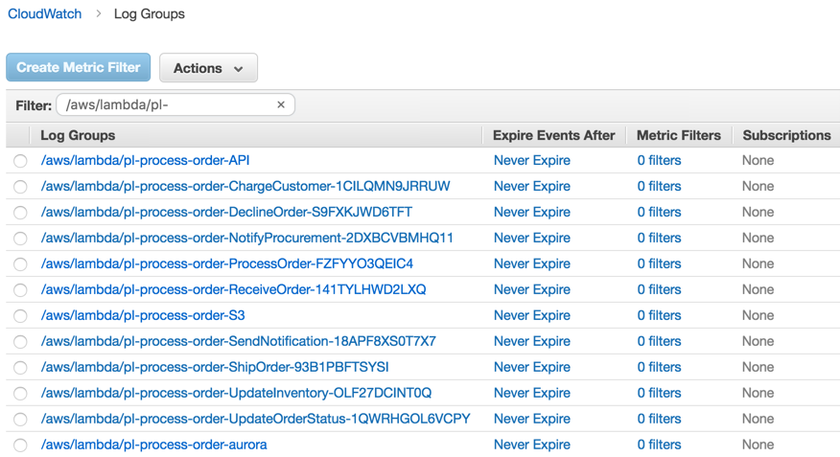
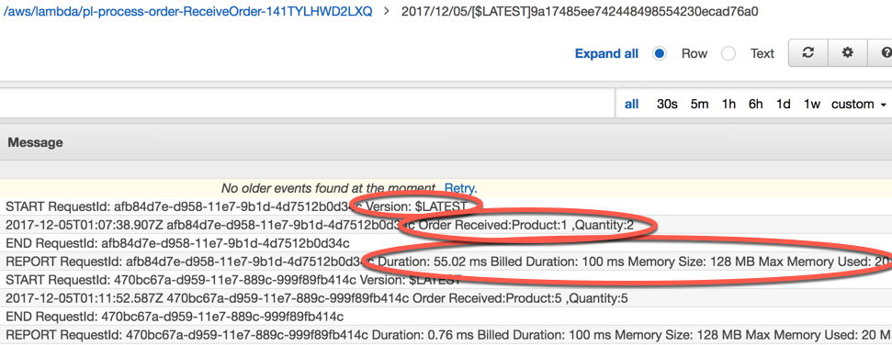
A Quick Check of the CloudWatch Logs

Slide 25
Order Processing Aurora Integration
Update IAM Role (if needed / private)
Create DB
Write lambda code
The pymysql SDK will need to be packaged within lambda
If the library isn’t provided by the base lambda SDK you can always package your own requirements
Create process-order-Aurora lambda function
Added WriteToAurora Step function and create a branch
Test Lambda -> Aurora flow

Slide 26
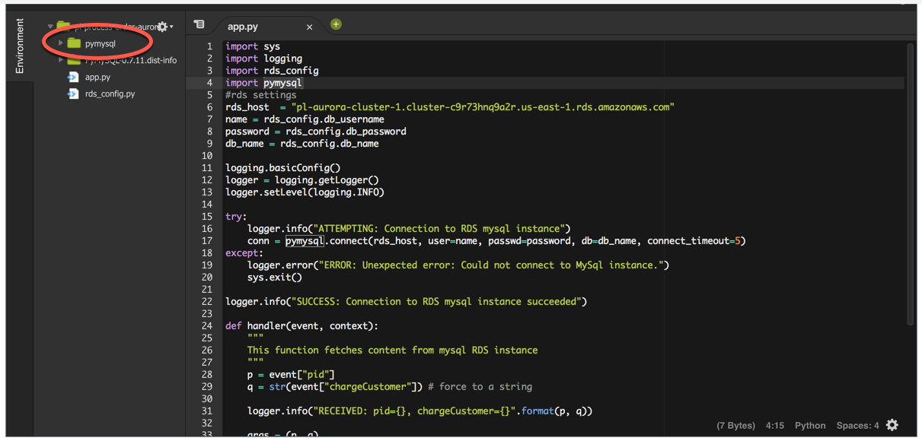
Order Processing Aurora Integration

Slide 27
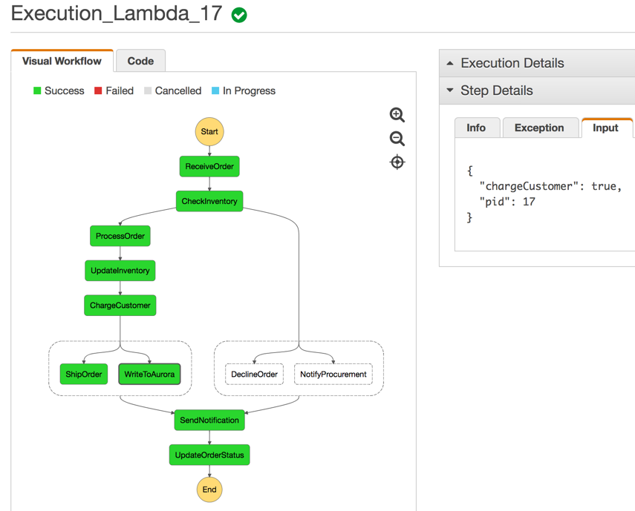
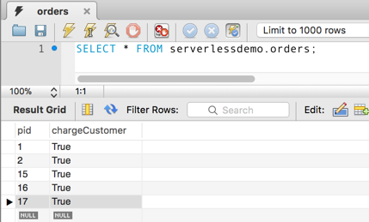
Order Processing Aurora Integration

Slide 28
Notes on RDS & Aurora
AWS Traditional SQL Databases - RDS - Relational Data Service
Benefits:
Highly scalable, available, and durable
Easy to administer
Fast
Secure
Use cases include:
Web and mobile apps
Mobile and online games
E-commerce applications
Currently 6 databases available
Amazon Aurora
MySQL
MariaDB
PostgreSQL
Oracle
SQL Server

Slide 29
Notes on RDS & Aurora
Managed service - User is not required to manage OS
No access provided to underlying OS
Can provision or resize resources (for example, storage, compute) on demand
Provided with an endpoint, which you can connect to using standard DB connection tools/libraries
Uses EBS Volumes for database and the log storage (Network mounted)
Three types of storage:
General purpose SSD (DB workloads with moderate I/O requirements)
Provisioned IOPS SSD (High perf OLTP workloads/fast & consistent perf)
Magnetic (Small DB's with infrequently accessed data/not recommended for Prod)
Automatic minor updates
Can schedule maintenance windows
Storage capacity for your DB can be increased while maintaining the DB's availability - DB processing will be uninterrupted
Can dynamically increase/decrease the compute resources available to your DB
However, DB will be temporarily unavailable while instance class is modified
Although, this can be scheduled for the next maintenance window

Slide 30
Notes on RDS & Aurora
Multi AZ
If you enable Multi-AZ on a database instance, RDS will automatically provision and manage a standby replica in a different AZ
Planned DB maintenance = automatic failover to the standby = no down time
Multi-AZ deployments utilize synchronous replication, making database writes concurrently on both the primary and the secondary - Although, cannot interact with the standby directly
Other features:
Automated backups
Retention period 1 - 35 days(default is 7)
0 means automated backups are disabled
RDS automatically performs a full daily snapshot of your data and captures transaction logs
Automated backups are deleted when the DB is deleted
Point-in-time recovery - transaction logs are applied to the latest backup
Can snapshot at any time - user initiated - Need to be explicitly deleted
Both backups and snapshots are stored in S3
When restoring a DB from either a manual snapshot or an automated backup, a new DB instance will be created an will have a new endpoint

Slide 31
Notes on RDS & Aurora
Read Replicas
For read-heavy database workloads
After creation, DB updates on the source DB instance will be propagated asynchronously
Can create multiple read replicas for a given source DB instance and distribute your application's read traffic across them
Read replicas are supported by Amazon Aurora, RDS for MySQL, MariaDB, and PostgreSQL
Uses native replication of the underlying DB engine
Automated backups must be enabled
Amazon Aurora
MySQL & PostgreSQL Compatible editions
Faster and more cost effective
Preferred offering
Amazon Aurora is a MySQL and PostgreSQL compatible enterprise-class database, starting at <$1/day.
Up to 5 times the throughput of MySQL and 3 times the throughput of PostgreSQL
Up to 64TB of auto-scaling SSD storage without impact on performance.
6-way replication across three Availability Zones
Up to 15 Read Replicas with sub-10ms replica lag
Automatic monitoring, issue detection, and failover in less than 30 seconds

Slide 32
Notes on RDS & Aurora
Amazon Aurora (continued)
Fault tolerant and self-healing storage, specific to Aurora DB's, and without loss of availability.
Aurora maintains 6 copies of your data across 3 availability zones
You can restore from a DB snapshot or perform a point-in-time (5 mines in the past) restore operation to a new instance.
Handles the loss of up to 2 copies of data without affecting the DB write availability and up to 3 copies without affecting read availability
Recent announcements:
Aurora multi-master (in preview)
Multiple master nodes across multiple AZs
Read or Write multiple masters in multiple data centers
No need to rewrite your application
Single region multi-master
Multi-region is coming in 2018
https://aws.amazon.com/about-aws/whats-new/2017/11/sign-up-for-the-preview-of-amazon-aurora-multi-master/
Aurora serverless (in preview)
Runs like Lambda
Pay by the second in which the DB is in use otherwise you only pay for the underlying storage cost.
https://aws.amazon.com/blogs/aws/in-the-works-amazon-aurora-serverless/

Slide 33
Recap
CloudFormation
Lambda
Step Functions
API Gateway
S3
CloudWatch
RDS - Aurora

Slide 34
Materials
All code examples and slides (this deck) will reside on a GitHub public repo, located at:
https://github.com/philiplavoie/AWS-StepFunctions-Lambda-Aurora

Slide 35


slalom.com
© 2016 Slalom, LLC. All rights reserved. The information herein is for informational purposes only and represents the current view of Slalom, LLC. as of the date of this presentation. SLALOM MAKES NO WARRANTIES, EXPRESS, IMPLIED, OR STATUTORY, AS TO THE INFORMATION IN THIS PRESENTATION.

